Slide 1
Computer Simulation and Modeling
Time-shared Computer Model

Slide 2
Introduction
A company has a computer system consisting of a single central processing unit (CPU) and n terminals.
The operator of each terminal “thinks” for an amount of time that is an exponential random variable with mean 25 seconds, and then sends to the CPU a job having service time distributed exponentially with mean 0.8 second.
Arriving jobs join a single queue for the CPU but are served in a round-robin rather than FIFO manner.

Slide 3
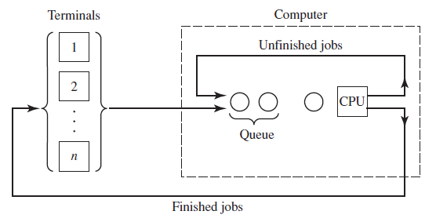
Introduction
CPU allocates to each job a maximum service quantum of length q = 0.1 second.
The remaining service time be s and a fixed swap time be τ = 0.015 seconds.
We need to simulate the system and estimate the expected average response time of these jobs, the expected time-average number of jobs waiting in the queue, and the expected utilization of the CPU.

Slide 4
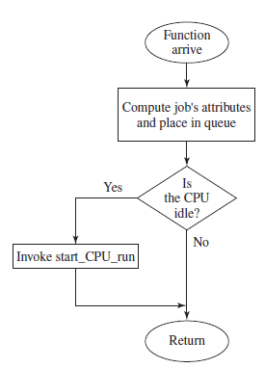
Function arrive()
Each job has its own record with attributes.
The time of arrival is stored in the first attribute and the total service requirement is generated and stored in the second attribute.
If it finds CPU idle, it invokes start_CPU_run().

Slide 5
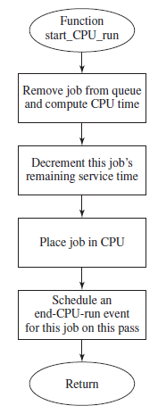
Function start_CPU_run()
The purpose of the function is
to take the first job out of the queue,
place it in the CPU, and
schedule the time when it will leave the CPU, by virtue of either being completely done or having used up an entire quantum.

Slide 6
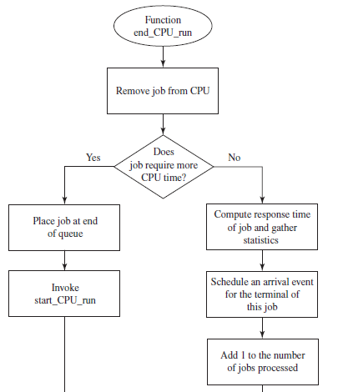
Function end_CPU_run()
First it checks whether the job requires more time.
If the job is finished, it computes the response time, R_{i} = sim_time – time of arrival.
Then it schedules another event for the terminal.

Slide 7
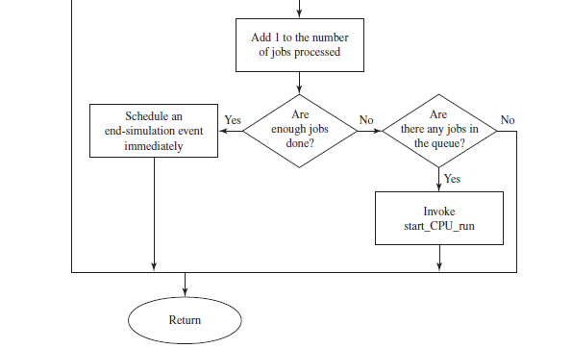
Function end_CPU_run()
Nevertheless, if enough jobs are done, it ends simulation.

